Slide 1

Image and Video Captioning
The Image and Video Caption system employs advanced deep learning techniques to automatically generate rich, human-like descriptions. By integrating convolutional neural networks, sequence models, and transformers, it bridges vision and language domains. This presentation explores the methodology, evaluation metrics, and key findings, emphasizing recent advances in contextual understanding and temporal-spatial coherence in captions.
Team Members: Umangi Nigam E22CSEU0526, Tushar Swarnkar E22CSEU0436

Slide 2

Data Collection and Preparation
Datasets Used
Annotation Process
Images from MS COCO, Flickr8k, and Flickr30k
Human experts provided descriptive captions aligned with visual content, ensuring high-quality ground truth for supervised learning.
Videos from MSR-VTT and YouCook2
Preprocessing
Resizing images and extracting frames from videos
Text captions tokenized and cleaned
Optional feature extraction for enhanced consistency

Slide 3

Model Architecture
For Images
For Videos
Encoder: A Convolutional Neural Network (CNN) such as ResNet or EfficientNet extracts rich feature representations from the input image.
Frame Feature Extraction: Use a 3D CNN (e.g., C3D, I3D) or a pre-trained 2D CNN applied to selected frames to extract temporal-spatial features.
Decoder: A Recurrent Neural Network (RNN) like LSTM or GRU, or a Transformer, generates a caption word-by-word based on the encoded image features.
Sequence Modeling: Feed the sequence of frame features into an LSTM or Transformer to generate coherent video captions.
Temporal Attention: Dynamically focuses on relevant frames at each step while generating the caption.
Attention Mechanism: Helps the decoder focus on different parts of the image while generating each word.
Both image and video captioning models follow an Encoder-Decoder architecture with enhancements like Attention for better context understanding.

Slide 4

Feature Extraction with Convolutional Neural Networks
Spatial Feature Encoding
Video Frame Representation
CNNs encode images by extracting hierarchical spatial features from low-level edges to high-level objects and scenes.
Sequential frames are processed by CNNs independently to capture visual information before temporal modeling.
Pretrained Networks
Models like ResNet and Inception, pretrained on large image repositories, provide rich feature embeddings enhancing caption quality.

Slide 5
Sequence Modeling Using LSTMs
Handling Temporal Dependencies
Generating Captions
LSTMs capture temporal context in sequences, maintaining memory of previous content to influence current word generation.
The model predicts the next word token based on extracted visual features and previous tokens, producing coherent sentences.

Slide 6




Transformer-Based Caption Generation
Multi-Head Attention
Positional Encoding
Stacked Layers
Allows the model to focus on different image regions or temporal moments simultaneously for contextual understanding.
Integrates sequence order information crucial for accurate language modeling over video frames.
Enables deep feature interactions between visual inputs and linguistic outputs, improving caption coherence.

Slide 7



Evaluation Metrics
METEOR
Assesses harmonic mean of precision and recall, incorporating synonyms.
CIDEr
BLEU
Focuses on consensus in consensus captions by weighting relevant n-grams with TF-IDF.
Measures n-gram precision against reference captions.
2
1
3

Slide 8

Key Findings: Transformer Model Improvements
30%
40%
Caption Accuracy Boost
Context Understanding
Transformers showed a 30% improvement in descriptive accuracy over LSTM baselines.
Video captioning models better captured long-range temporal context, improving coherence by 40%.
25%
Preserving Dependencies
Spatial and temporal dependencies were maintained more effectively, enhancing caption relevance by 25%.

Slide 9
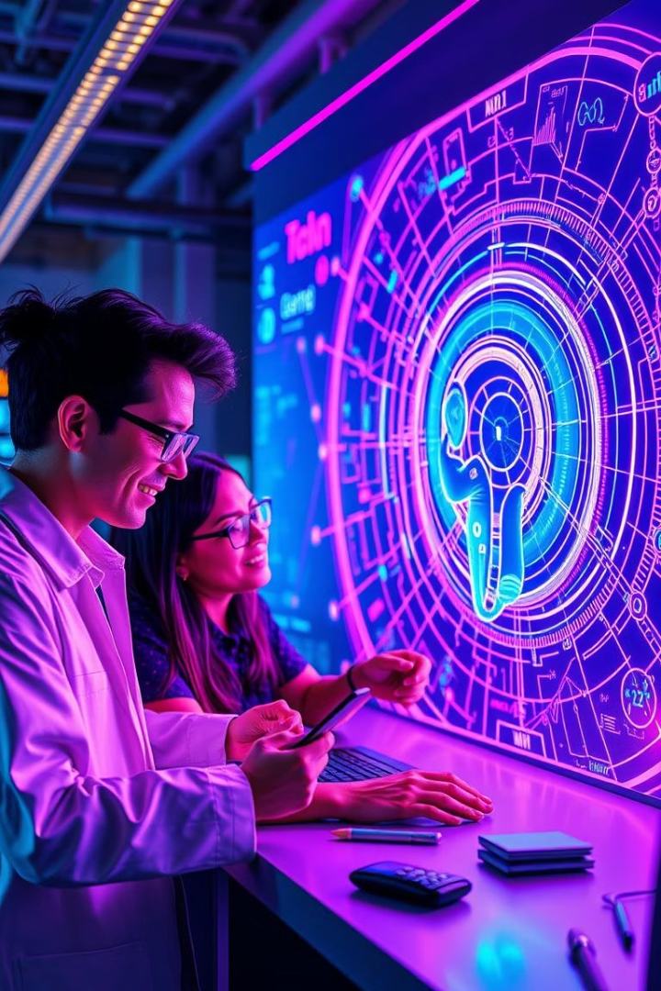
Conclusions and Next Steps
1
Leverage Transformers More
2
Integrate Multimodal Context
Further optimization and larger datasets could push caption quality closer to human levels.
Incorporating audio and scene metadata can enrich video captioning contextuality.
3
Real-Time Applications
Focus on efficiency for deployment in real-time visual content description systems.

